Slide 1


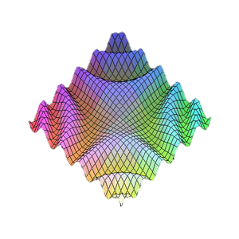

JavaScript Patterns
Private/Public fields, Module, Revealing Module
Telerik Software Academy
Learning & Development Team
http://academy.telerik.com

Slide 2

Table of Contents
Public/Private fields in JavaScript
Module pattern
Revealing module pattern
Revealing prototype pattern
Singleton pattern

Slide 3
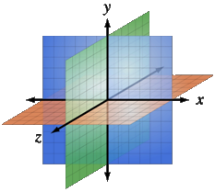
Public/Private fields
Using the function scope

Slide 4
Public/Private Fields
Each variable is defined:
In the global scope (Public)
In a function scope (Private)
var global = 5;
function myFunction() {
var private = global;
function innerFunction(){
var innerPrivate = private;
}
}

Slide 5

Public/Private fields
Live Demo

Slide 6
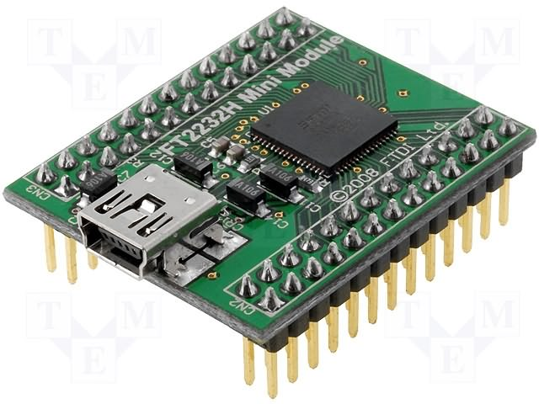
The Module Pattern
Hide members

Slide 7
Pros and Cons
Pros:
“Modularize” code into re-useable objects
Variables/functions not in global namespace
Expose only public members
Cons:
Not easy to extend
Some complain about debugging

Slide 8
Module Pattern: Structure
Structure:
var module = (function() {
//private variables
//private functions
return {
//public members
someFunc: function() {…},
anotherFunc: function() {…}
};
}());

Slide 9
Module Pattern: Example
Example:
var controls = (function () {
//hidden members
function formatResult(name, value) { //… }
//visible members
return {
Calculator: function (name) {
var result;
result = 0;
this.add = function (x) { //… };
this.subtract = function (x) { //…};
this.showResult = function () { //… };
}
};
}());
var calc = new controls.Calculator('First');
calc.add(7);
calc.showResult();

Slide 10
Module Pattern: Example
Example:
var controls = (function () {
//hidden members
function formatResult(name, value) { //… }
//visible members
return {
Calculator: function (name) {
var result;
result = 0;
this.add = function (x) { //… };
this.subtract = function (x) { //…};
this.showResult = function () { //… };
}
};
}());
var calc = new controls.Calculator('First');
calc.add(7);
calc.showResult();
The visible members create closures with them

Slide 11
Module Pattern: Example
Example:
var controls = (function () {
//hidden members
function formatResult(name, value) { //… }
//visible members
return {
Calculator: function (name) {
var result;
result = 0;
this.add = function (x) { //… };
this.subtract = function (x) { //…};
this.showResult = function () { //… };
}
};
}());
var calc = new controls.Calculator('First');
calc.add(7);
calc.showResult();
Visible function constructor

Slide 12
Module Pattern: Summary
Module pattern provides encapsulation of variables and functions
Provides a way to add visibility (public versus private) to members
Each object instance creates new copies of functions in memory

Slide 13

Module Pattern
Live Demo

Slide 14

The Revealing Module Pattern
Reveal the most interesting
members

Slide 15
Revealing Module Pattern: Pros and Cons
Pros:
“Modularize” code into re-useable objects
Variables/functions taken out of global namespace
Expose only visible members
"Cleaner" way to expose members
Easy to change members privacy
Cons:
Not easy to extend
Some complain about debugging
Hard to mock hidden objects for testing

Slide 16
Revealing Module Pattern: Structure
Structure:
var module = (function() {
//hidden variables
//hidden functions
return {
//visible members
someFunc: referenceToFunction
anotherFunc: referenceToOtherFunction
};
}());

Slide 17
Revealing Module Pattern: Example
Example:
var controls = (function () {
//hidden function
function formatResult(name, value) { // … }
var Calculator = (function () {
var Calculator = function (name) { // … };
Calculator.prototype.add = function (x) { // … };
Calculator.prototype.subtract = function (x) { // … };
Calculator.prototype.showResult = function () { // …};
return Calculator;
}());
return {
Calculator: Calculator
};
}());
var calc = new controls.Calculator('First');

Slide 18
Revealing Module Pattern: Example
Example:
var controls = (function () {
//hidden function
function formatResult(name, value) { // … }
var Calculator = (function () {
var Calculator = function (name) { // … };
Calculator.prototype.add = function (x) { // … };
Calculator.prototype.subtract = function (x) { // … };
Calculator.prototype.showResult = function () { // …};
return Calculator;
}());
return {
Calculator: Calculator
};
}());
var calc = new controls.Calculator('First');
Create the function constructor hidden

Slide 19
Revealing Module Pattern: Example
Example:
var controls = (function () {
//hidden function
function formatResult(name, value) { // … }
var Calculator = (function () {
var Calculator = function (name) { // … };
Calculator.prototype.add = function (x) { // … };
Calculator.prototype.subtract = function (x) { // … };
Calculator.prototype.showResult = function () { // …};
return Calculator;
}());
return {
Calculator: Calculator
};
}());
var calc = new controls.Calculator('First');
Expose (reveal) only references to hidden member

Slide 20
Revealing Module Pattern: Summary
Module pattern provides encapsulation of variables and functions
Provides a way to add visibility (public versus private) to members
Extending objects can be difficult since no prototyping is used

Slide 21
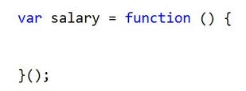
Revealing Module Pattern
Live Demo

Slide 22

The Revealing Prototype Pattern
Reveal the most interesting members (again)

Slide 23
Revealing Prototype Pattern: Pros and Cons
Pros:
“Modularize” code into re-useable objects
Variables/functions taken out of global namespace
Expose only public members
Functions are loaded into memory once
Extensible
Cons:
"this" can be tricky
Constructor is separated from prototype

Slide 24
Revealing Prototype Pattern: Structure
Structure:
var Constructor = function () {
//constructor defined here
}
Constructor.prototype = (function() {
//hidden variables
//hidden functions
return {
//exposed members
someFunc: pointerToSomeFunc
anotherFunc: pointerToAnotherFunc
};
}());

Slide 25
Revealing Prototype Pattern: Example
Example:
var Calculator = function (name) { // … };
Calculator.prototype = (function () {
var add, subtract, showResult, formatResult;
add = function (x) { // … };
subtract = function (x) { // … };
showResult = function () { // … };
formatResult = function (name, value) { // … };
return {
add: add,
subtract: subtract,
showResult: showResult
};
}());
var calc = new Calculator('First');

Slide 26
Revealing Prototype Pattern: Summary
Module pattern provides encapsulation of variables and functions
Provides a way to add visibility (exposed versus hidden) to members
Provides extension capabilities

Slide 27

Revealing Prototype Pattern
Live Demo

Slide 28

Singleton Pattern
One object to rule them all!

Slide 29
Singleton Pattern: Structure
Structure:
var module = function() {
var instance, getInstance;
return {
getInstance: function(){
if(!instance){
instance = new Instance();
}
return instance;
}
};
}();

Slide 30
Singleton Pattern: Example
Example:
var controls = function () {
var Calculator, calculatorInstance;
Calculator = (function () {
function Calculator() { //… }
return Calculator;
}());
return {
getCalculator: function () {
if (!calculatorInstance) {
calculatorInstance = new Calculator();
}
return calculatorInstance;
}
};
}();
var calculator = controls.getCalculator();

Slide 31

Singleton Pattern
Live Demo

Slide 32
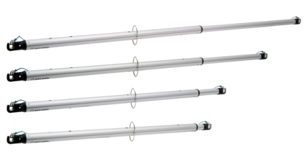
Augmenting Modules
Live Demo

Slide 33

Arrays
http://csharpfundamentals.telerik.com

Slide 34
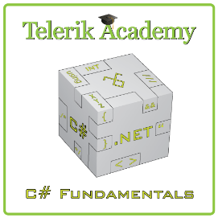



Free Trainings @ Telerik Academy
“C# Programming @ Telerik Academy
csharpfundamentals.telerik.com
Telerik Software Academy
academy.telerik.com
Telerik Academy @ Facebook
facebook.com/TelerikAcademy
Telerik Software Academy Forums
forums.academy.telerik.com

Slide 35
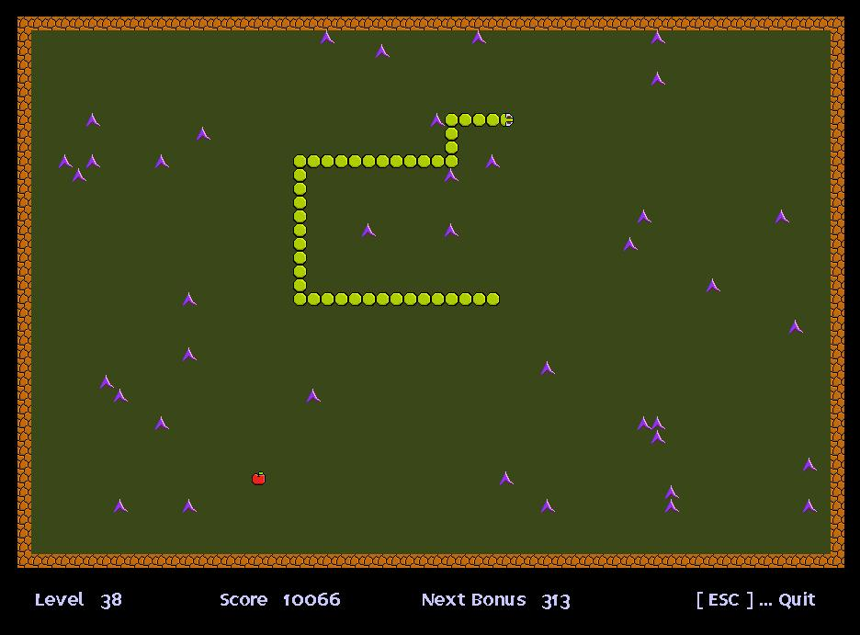
Homework
Create the Snake game using the Revealing module pattern. Design the game such that it has at least three modules.

